Slide 1
Self sustained automated cultivation with remote monitoring
TEAM : CHITLURU VENKATA BHANU PRAKASH (S20200020255)
BTP Code : B23PB01
Mentor : Dr.Paul Braineard

Slide 2
Outline
Introduction
Literature review
Objectives
Hardware Implementation
Block Diagram
Conclusion
References

Slide 3
Introduction
The primary aim of this project is to create an automated watering system.
It is designed for remote monitoring from the comfort of one's home.
The project also explores various energy harvesting techniques, including solar and piezoelectric methods.
It incorporates theft detection through computer vision to enhance security.

Slide 4
Literature review
Reference 1: An Automatic Irrigation System is a sophisticated solution that optimizes the watering process, conserves water, and enhances the health of plants while
providing convenience to users, especially in agriculture and landscaping.
Reference 2: Remote monitoring of a water pump involves using smart technology, and
user-friendly interfaces to provide real-time status updates and control options for the pump from anywhere with an internet connection.
Reference 3: YOLO(You Only Look Once) Architecture and it’s working.

Slide 5
Objectives
Our system offers remote farm monitoring with both automated and manual irrigation capabilities.
It utilizes LoRa WAN technology to transmit data even in remote areas lacking internet connectivity.
Solar energy harvesting is employed to ensure sustainable power supply.
Furthermore, the system includes trespasser detection features and can promptly alert the user upon detecting unauthorized individuals on the premises.

Slide 6
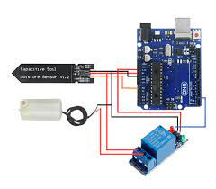
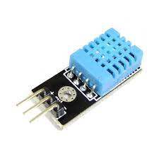
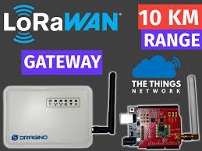
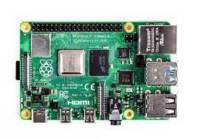
Hardware Tools Used
DHT11
Soil moisture sensor
Relay
Water Pump
Arduino Uno
LoRa Module
Raspberry Pi
LCD display

Slide 7
Software Tools Used
Arduino IDE
Putty
VNC Viewer
Raspberry Pi Imager
Programming Languages
Yolo V8
OpenCV
Ultralytics

Slide 8
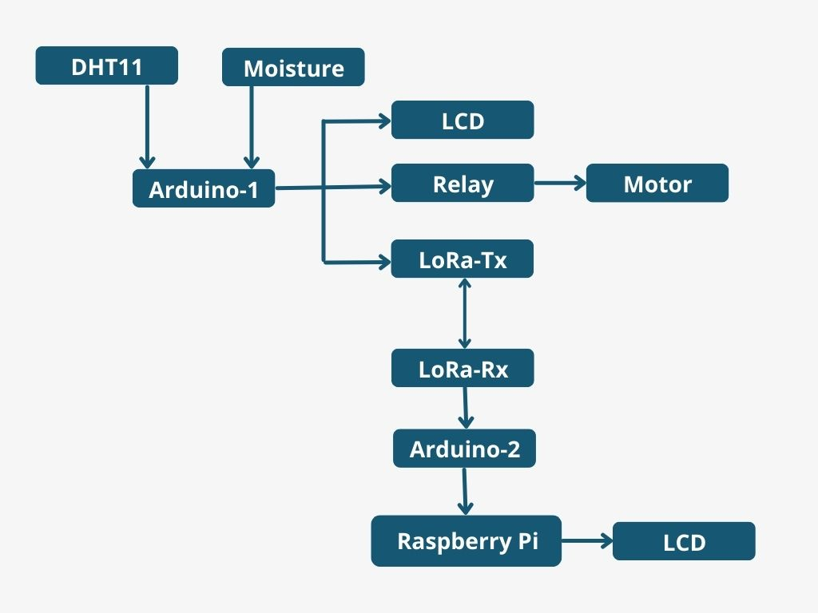
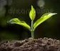
Block Diagram
Collecting humidity, temperature from DHT11, and soil moisture from soil moisture sensor to Arduino Uno-1.
Arduino Uno-1 commands relay to turn on pump if moisture percentage is less than 50.
The data will be sent to receiver using Wireless Communication.

Slide 9
Block Diagram
The data will be sent to LoRa Rx at 868MHz.
The range is a 13kms if we use gateway.
Arduino Uno-2 will receive data from LoRa Tx and share with Raspberry Pi using USB serial communication.
Display the data in LCD which is connected to Raspberry Pi via I2C.

Slide 10
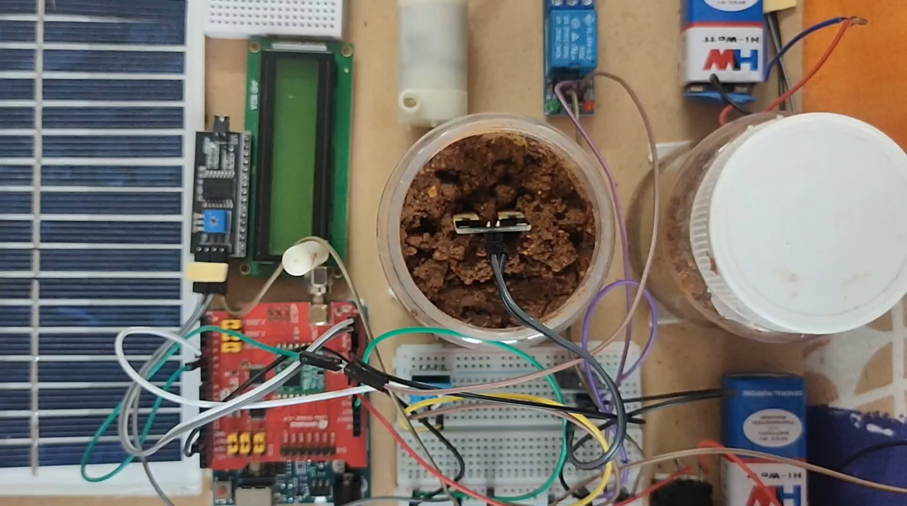
Results

Slide 11
YOLO V8 Model for Object Detection
The YOLO(You Only Look Once) Version 8 model is a powerful deep learning model designed for efficient object detection.
It's capable of identifying objects in a single pass, making it highly efficient.
To train and evaluate this model, I utilized the COCO dataset, which encompasses a rich diversity of object classes, including but not limited to persons, dogs, cats, cow, sheep, and many more, totaling 91 categories.

Slide 12
Future scope of evaluation
Our objective is to fine-tune the model to exclusively detect specific objects: persons, cats, dogs, cows, sheep, bicycles, and motorcycles.
Whenever the model identifies any motion involving these objects, an alarm notification will be sent to the user.

Slide 13
Conclusion
Irrigation is initiated based on soil moisture levels, with the Arduino autonomously controlling the pump's operation.
The farmer can conveniently monitor the farm remotely from their home.
The system employs solar energy harvesting techniques for power efficiency.
Additionally, it incorporates computer vision for detecting trespassers and issuing alert messages when unauthorized individuals are detected.

Slide 14
References
THILAGAVATHI, S., AISHWARYA RAJENDRAN, and K. PRIYADHARSHINI. "AUTOMATIC PLANT IRRIGATION SYSTEM." (2016). [Reference 1]
S.Parthiban & V.P.Santhi & M.S.Snehapriya & K.Indumathi & P. Masilamani. "Recent Advances in Enhancing the Productivity of Mango through Hi-tech Practices." (2020)[Reference 2]
Biswas, B., and Lalit Kumar. "Revolution of Mango production." Fertilizer Marketing News (2011): 1-24. [Reference 3]

Slide 15
Questions?

